Slide 1
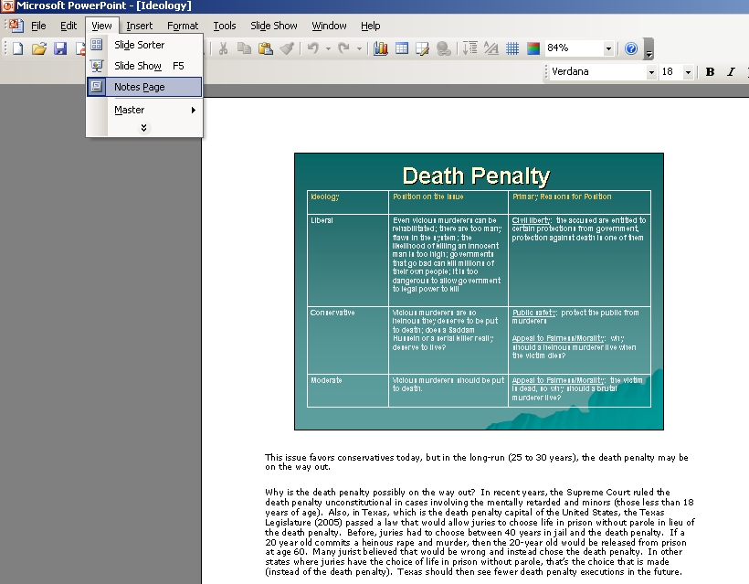
Settings
To view PowerPoint notes, open the PowerPoint file, click on the “view” menu and then select “notes page” from the pull-down menu
Here is the PowerPoint slide
If you use PowerPoint 2003, and if the notes are lengthy, when you print, the notes will be truncated. In this case, to print all of the PowerPoint notes, you will need to cut and paste the notes into a Word file.
If you use PowerPoint 2010, all of the notes will print
Here are the PowerPoint Notes, which are located below the slide

Slide 2
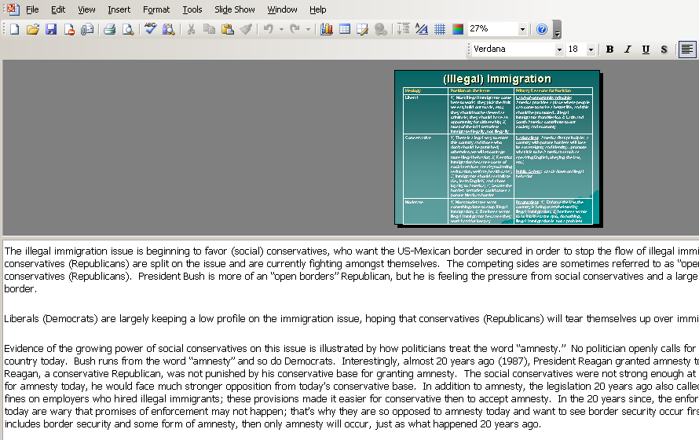
You can also view notes by clicking on the bar below the PowerPoint slide (see where arrows are pointing) and then dragging the bar up

Slide 3
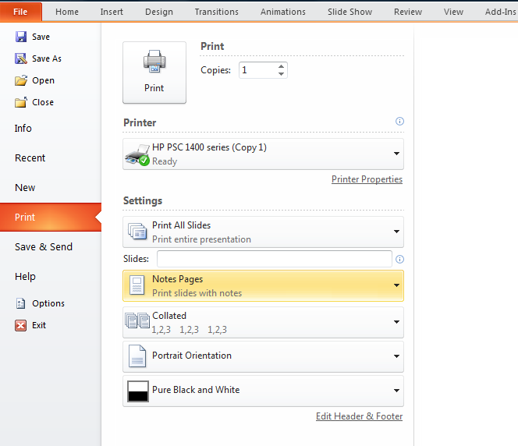
Printing
Here are the steps to print a PowerPoint presentation so that you can view the notes and the slides:
Go to the “File” menu option on the PowerPoint
Select “Print”
Select “Notes Pages” from this pull-down dialogue box
Also, be sure to select “Pure Black and White” from this pull-down menu
Then, click the “Print” button at the top.

